Slide 1
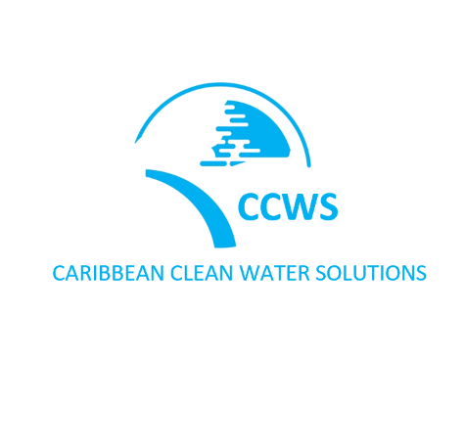
Resilience Consulting S.R.L.
CARIBBEAN CLEAN WATER
Clean Water Pilot Project - Sabana Grande de Palenque - Dominican Republic
Making Money Matter: Impact Investing to Change the World
Creating 1,000 new jobs
December 2022
PRIVILEGED & CONFIDENTIAL

Slide 2
Clean Water Pilot Project Dominican Republic
Initiator/Project Developer:
Resilience Consulting S.R.L.
Buyer/Production Unit:
Dr. Fechter Clean City Singapur S.R.L., a 100% subsidiary of Dr. Fechter Clean City GmbH, Germany
Clean Water Technology Provider:
Solar Water Solutions Oy Ltd, Finland, with over 140+ already installed and operating locations worldwide.
Local Supporter/Partner:
Dominican Federation of Municipal Districts (FEDODIM)
Dominicana Limpia
Project Volume:
USD 500,000
Investment Strategy:
Project development of the Caribbean Clean Water Solutions Pilot Project in Los Botados, Dominican Republic until “Shuffle Ready” by Initiator and project sales to Buyer.
Water Solution Product:
SolarRO 500 BW water desalination product
Location:
Sabana Grande de Palenque, San Cristóbal Province, Dominican Republic
A major problem in the Dominican Republic, as well as the rest of the Caribbean, is the supply of clean drinking water to its population. Tap water is not suitable as drinking water and drinking water is usually purchased in packaged form. Nevertheless, a significant portion of the population often has no or only limited access to sufficient clean water.
Initiator: Resilience Consulting S.R.L.
Resilience Consulting S.R.L. is the initiator and project developer for Solar Water Solutions Oy Ltd, Finland projects (https://solarwatersolutions.fi/en) in the Dominican Republic. Resilience Consulting S.R.L. will be responsible for the project management and development as well as the business management and O&M with the production and product distribution.
Through its people behind, Resilience Consulting S.R.L. bundles over 14 years of track record in the Dominican Republic with a well-balanced team with specialists in international project management, project development and implementation as well as corporate development and corporate finance. Resilience Consulting S.R.L. is through its people behind associated with GEDER project companies and FCC-Energy - Dr. Fechter Clean City Waste-to-Energy projects.
Buyer: Dr. Fechter Clean City S.R.L.
Dr. Fechter Clean City Singapur S.R.L., a 100% subsidiary of Dr. Fechter Clean City GmbH, Germany (https://fcc-energy.com) is the buyer of the project and the future clean water production unit in the Dominican Republic.
As part of the Dr. Fechter Group of Companies with more than 38 years of activity in the field of environmental technologies, Dr. Fechter Clean City GmbH specializes with its subsideries in the developing and running of sustainable Clean Water, Waste-to-Energy and Photovoltaic projects.
Goal:
To provide clean water production and social water supply generating social, environmental and economic benefits.
PRIVILEGED & CONFIDENTIAL

Slide 3
The Market
Imagine a country where a major part of its population uses bottled water as a source of drinking water, because of a lack of access to clean drinking water. This is not a desert area, or an area with low rainfall. It is the Dominican Republic.
While access to water and basic sanitation is almost universal, service is deficient and very limited. The poor quality of the water and the service forces the Dominicans to resort to bottled water, which is more expensive.
The situation has been worsening over the years: in 1990, 13% of the urban population and 0.7% of the rural population used bottled water as a source of drinking water. In 2016, according to the latest record, that figure amounted to 89% of the urban population and 68% of the rural population.
And the poor suffer the most from this torment. 40% of the most vulnerable households spend 12% of their income to purchase water and, of that percentage, 95% is for bottled water that they buy from private companies.
Potential: Sabana Grande de Palenques pilot project with approximately 642,000 inhabitants in San Cristóbal Province. Countrywide, 5 million inhabitants are reached via 235 municipalities belonging to the Dominican Federation of Municipal Districts (FEDODIM).
The Caribbean Clean Water Solutions project provides a decentralized solution for producing affordable drinking water locally, where it is needed. Production and marketing are guided by social, environmental and economic principles.
Two sales streams are targeted to reach all segments of the population according to their needs.
The first sales stream is the conventional drinking water market. Here a brand product shall be placed, which is to possess the following characteristics:
Clean drinking water quality
Priced in the lower market segment
Impact aspect: Consumers achieve a social, environmental and price-related benefit with their purchase. Income streams from the conventional drinking water market serve the economic viability of the project and support the second sales stream, the social drinking water supply.
The second sales stream is the social drinking water supply. Sales are made in cooperation with the local communities and are intended to reach those parts of the population that are cut off from the conventional drinking water market due to poverty. Here, drinking water shall be offered at a low-profit / cost-covering, possibly subsidized price or as donation.
PRIVILEGED & CONFIDENTIAL

Slide 4
“The main objective of the Dominican Federation of Municipal Districts (FEDODIM) is to increase the number of people able to reach an adequate level of health and development through the installation of improved water sources in rural and semi-urban municipal districts of the Dominican Republic. To achieve this goal, FEDODIM offers its assistance to carry out projects for the construction of systems that guarantee the supply of drinking water.“
Ramon Santos
Mayor of Los Botados, Monte Plata and President of FEDODIM
Pilot Project Sabana Grande de Palenque DR
Resilience Consulting S.R.L. has already presented the solution to the Dominican Federation of Municipal Districts (FEDODIM), which consists of all decision-makers of the individual Dominican provinces.
The FEDODIM has given green light to the Sabana Grande de Palenque Pilot Project and signalled its agreement and common understanding to a comprehensive countrywide implementation.
The site for the pilot project is already selected and preliminary inspection by engineers is done.
The target of the pilot project is to create a best practice model for a decentralized water supply that reaches all groups of the population and supplies them with affordable drinking water. The pilot project shall serve as an initiator and concept provider for a subsequent expansion.
PRIVILEGED & CONFIDENTIAL

Slide 5
Business Target & Outlook
Business Target: After successful completion of the pilot project in Sabana Grande de Palenque there is the opportunity of scaling through countrywide installations.
Potential: 1 National District, 31 Provinces, over 200 Municipalities with demand.
Opportunity: Includable in an integrative sustainability concept with clean water solutions, solar power and Dr. Fechter Clean City waste-to-energy solutions, providing:
Security of supply through clean water
Security of supply through green energy
Sustainable waste recycling
Creation of jobs & increase of environmental awareness
Benefit: Creating social, ecological and economical IMPACT, like:
Clean and economically efficient drinking water production from renewable energies
Creation of economic development involving local communities for handling the social water distribution
Creation of jobs in different economic sectors and different qualification requirements
Profitable economic model through customer mix (social, conventional)
Providing drinking water to people who until now have been cut off from clean and affordable drinking water
PRIVILEGED & CONFIDENTIAL

Slide 6
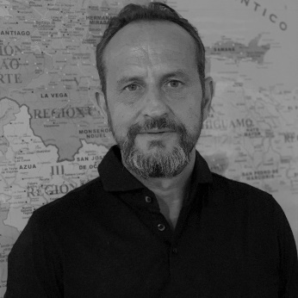
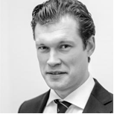
Key people
Stefan is German citizen and based in the Dominican Republic and Co-Initiator of the Project. He has been working as impact project developer in the Dominican Republic since 2007. His areas of expertise include among others integrative sustainability concepts, photovoltaic power plants (GEDER), waste to energy plants (FCC-Energy) and water preparation solutions.
With his initiative GEDER he was co-initiator of the Dominican Renewable Energy Law and provided advice to the Dominican government during the development of Dominican Renewable Energy Act (Law 57-07 ) based on the German model (EEG).
Stefan is leader in signing PPAs in the Dominican Republic.
Over 600MWp developments of photovoltaic (Spain and DR). Furthermore, approx. 1GWp photovoltaic currently in under development in the Dominican Republic.
Stefan Schwind
Managing Director
Resilience Consulting S.R.L.
Co-Initiator
Lorenz is German citizen and Co-Initiator of the Project. He is resident in the Dominican Republic and professionally based in London and the Dominican Republic.
As Partner for Corporate Advisory at HPL Lawyers, Tax Advisors and Business Advisors (www.hplaw.com) Lorenz has many years of experience as an international business advisor with a strong focus on corporate development, business development and corporate finance. Furthermore, he has a strong focus on impact investment projects within the Caribbean region.
Lorenz is member of the Economic Council (Wirtschaftsrat der CDU e.V.) in Germany and speaks German, English and Spanish.
Lorenz Sondergeld
Dipl.-Pol. B.Sc. Econ
Co-Initiator
PRIVILEGED & CONFIDENTIAL

Slide 7
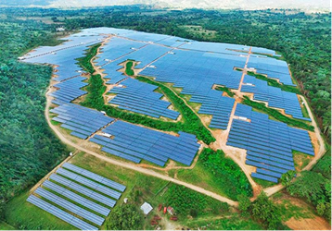
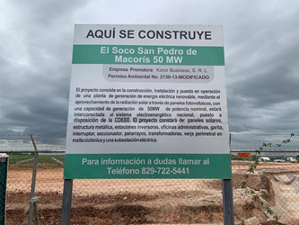
Selected references
Other projects driven by the project`s development team in DR
Photovoltaic plant, EL SOCO, San Pedro de Macoris
78MWn photovoltaic plant (50MWn first phase) in operation since 2022 under a power purchase agreement (PPA) with the state-owned power company.
Photovoltaic plant, Monte Plata
67MWn photovoltaic plant in operation since 2016 under a power purchase agreement (PPA) with state-owned power company.
CONFIDENCIAL Y PRIVILEGIADO

Slide 8
Investment Opportunity
Type and Conditions
Investment type: Loan
Investment amount: USD 500,000
Interest rate: 8% p.a. (paid in arrears)
Duration: 2 years
Investor role: Any; active role or the exploitation of possible synergy effects is welcomed as well.
Use of funds
The capital will be used to finance the project development the pilot project (Sabana Grande de Palenque) as initial project for a countrywide clean water project roll out. The project development of the pilot project is consisting of:
Land acquisition
Obtaining the building permit from the local municipality
Plant engineering and construction
Registration with the Ministry of Health
Obtaining the operating permit
Obtaining the distribution permit
Import and customs support
PRIVILEGED & CONFIDENTIAL

Slide 9
Resilience Consulting S.R.L. Av. Playa Palenque, calle sexta #15
Sabana Grande de Palenque
91600 San Cristóbal
Dominican Republic
in cooperation with
Dr. Fechter Clean City GmbH
Goerzalle 305e
14167 Berlin
Germany
Contact
Stefan Schwind
Phone: +1 (829) 381-5361
Mail: pss@fcc-energy.com
Disclaimer
This material is intended exclusively for your personal use and has been prepared solely for informational purposes. The notification, publication, duplication or transmission of the contents, irrespective of the form, to unauthorized persons is not permissible.
The presentation was not prepared with the intention of providing legal or tax advice. We assume no responsibility for the completeness, reliability or accuracy of the material, or of any other information that may be conveyed to the recipient in writing, verbally or in any other manner unless caused by our own willful conduct or gross negligence. The data given in this presentation have been derived from published sources and are assumed to be correct but have not been independently verified. The contents of this presentation shall not be legally binding, either in their entirety or in part, unless this has been expressly stipulated in writing. Statements made to recipients of the material are subject to the provisions of any underlying offer or contract that may have been made or concluded.
© 2022 | Resilience Consulting S.R.L.
PRIVILEGED & CONFIDENTIAL

